Slide 1
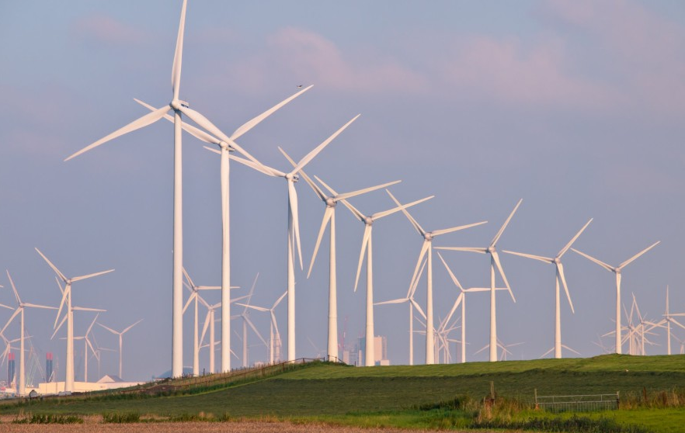
WIND OUTPUT ENERGY PREDICTION
BY : Aleena Umar

Slide 2
INDEX
Introduction
Necessity of the project
Project requirements
Flow Chart
Making of the project :-
Creating IBM account
# Accessing IBM Watson studio
# Writing Python code in IBM Watson notebook
# Creating Node-red flow
# Viewing the UI
Future scope

Slide 3
Introduction
Wind energy plays an increasing role in the supply of energy world wide. The energy output of a wind farm is highly dependent on the wind conditions present at its site. If the output can be predicted more accurately, energy suppliers can coordinate the collaborative production of different energy sources more efficiently to avoid costly overproduction.
Thus we aim to build a model which can predict this accurately as compared to present solutions.
We will be developing a machine learning model to Predict the power output of wind farm based on the previous data.
This prediction and other useful features related to this will be incorporated into an application for user display.

Slide 4
NECESSITY OF THE PROJECT
As electricity and power is the backbone of any industry and if it is generated from a renewable resource, it makes the working all the more efficient. If energy output of wind farm can be predicted it can be optimised, which in long run leads to :-
Growth of economy
A great move towards sustainable development.
Meeting the power requirements of all places.
Enhance the present production.

Slide 5
Project Requirements
IBM Cloud account
Nodered
Python coding
Open weather API
Github account

Slide 6
FLOW CHART
Input Parameters from user
UI
[Made on Node-red]
Predicted Output
Deployment
ML Model to predict
[Made on IBM Watson]

Slide 7
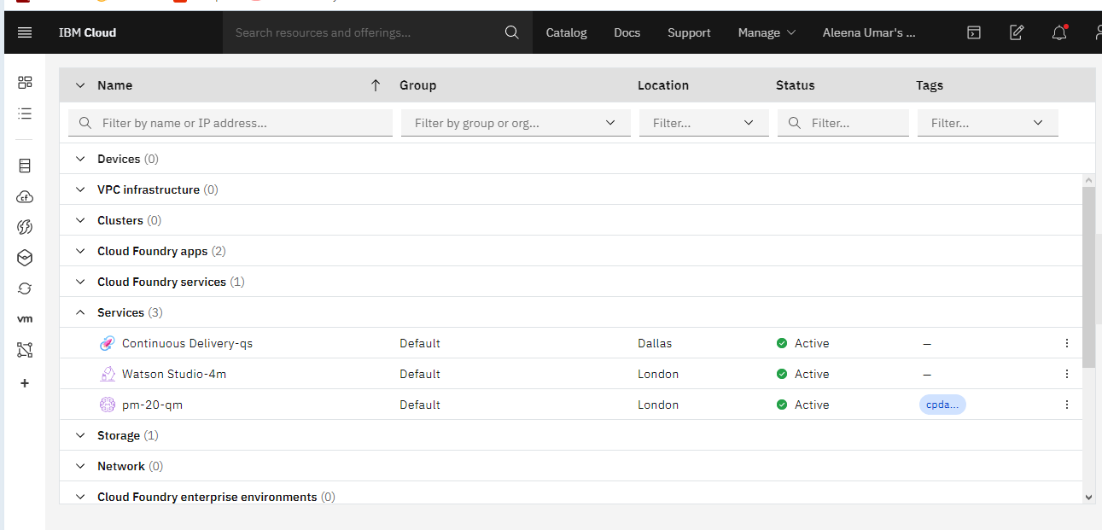
Making Of The project
Creating IBM Account

Slide 8
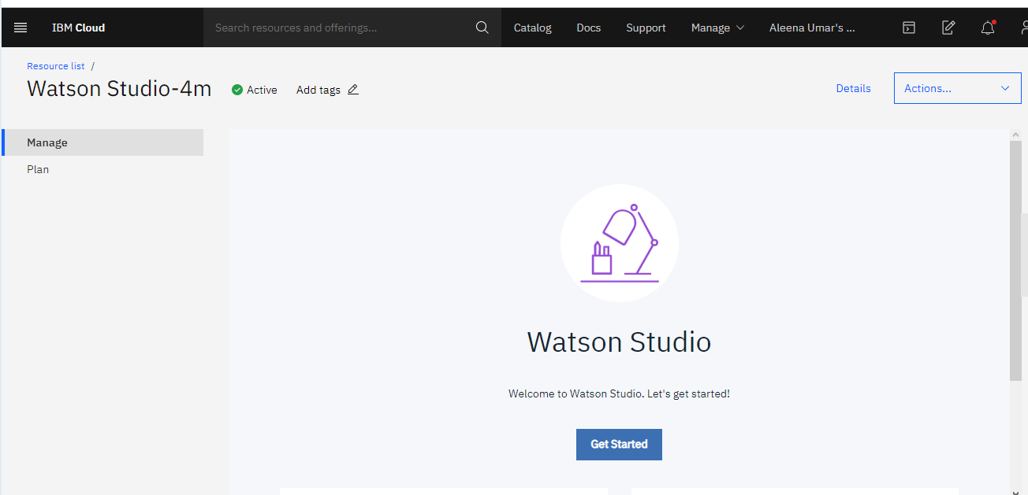
Building ML Model
Accessing IBM Watson

Slide 9
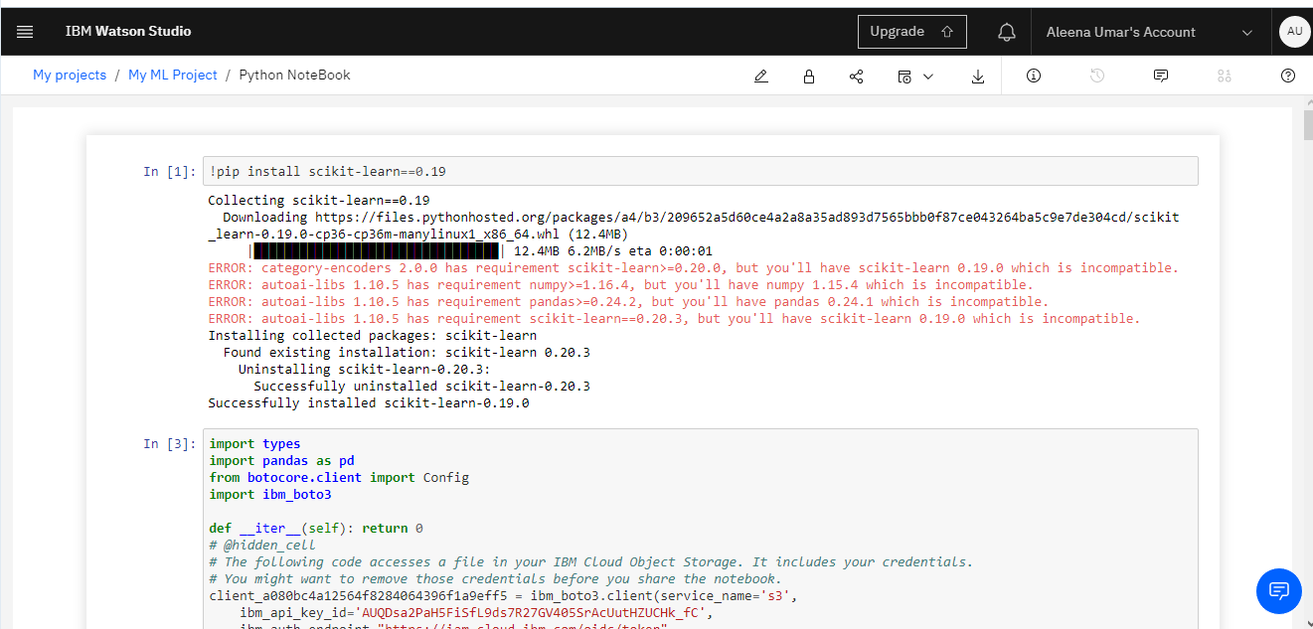
Writing Python code in IBM Watson notebook

Slide 10
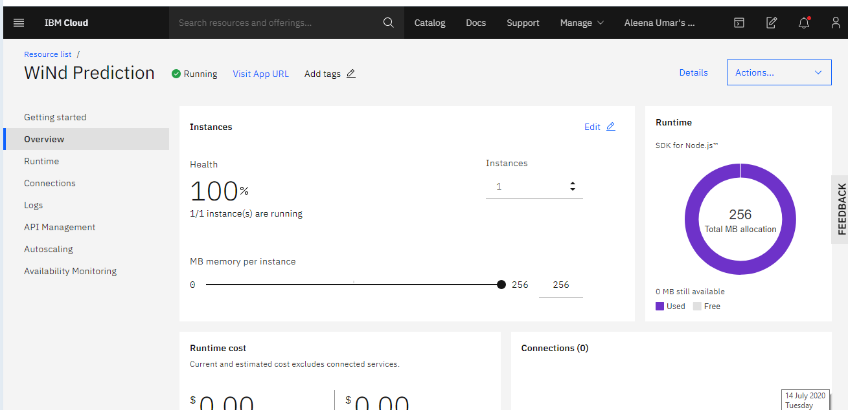
Creating UI
Create application on node-red

Slide 11
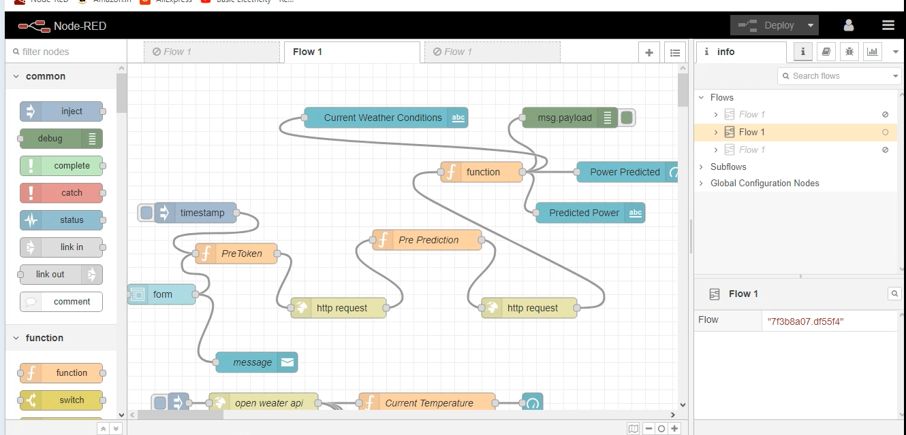
Creating the node-red flow

Slide 12
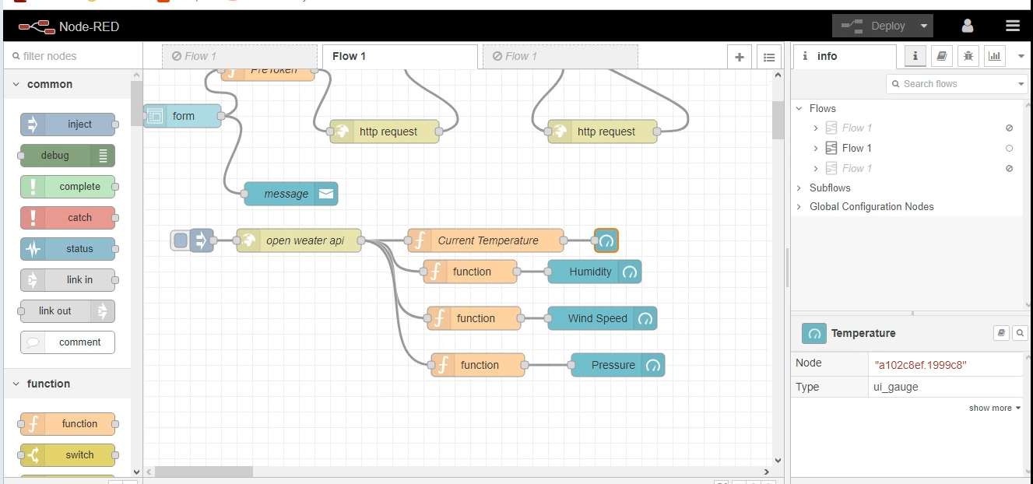

Slide 13
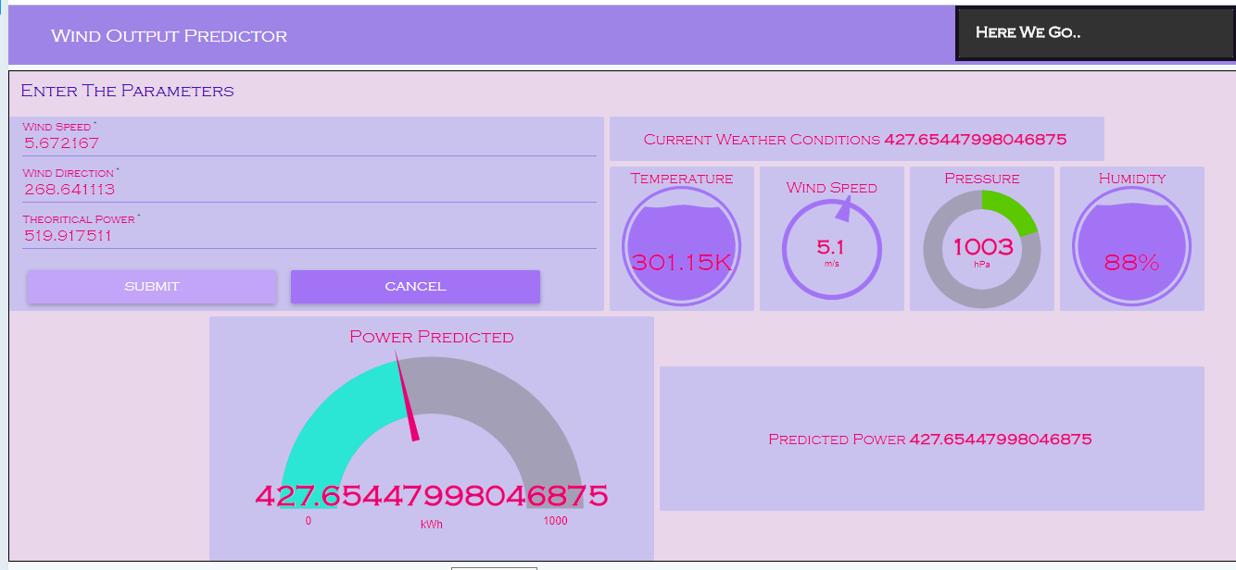
Viewing the UI

Slide 14
Future Scope
If the output energy of the find farms will be predicted then we can open gateways to many brighter opportunities for our country like :-
Increase employment
Move towards sustainable development

Slide 15
Thankyou

